Slide 1




22/03/2024
Pendi, Huber, Meierlohr, Hörter
St. Gallen, CH

Slide 2

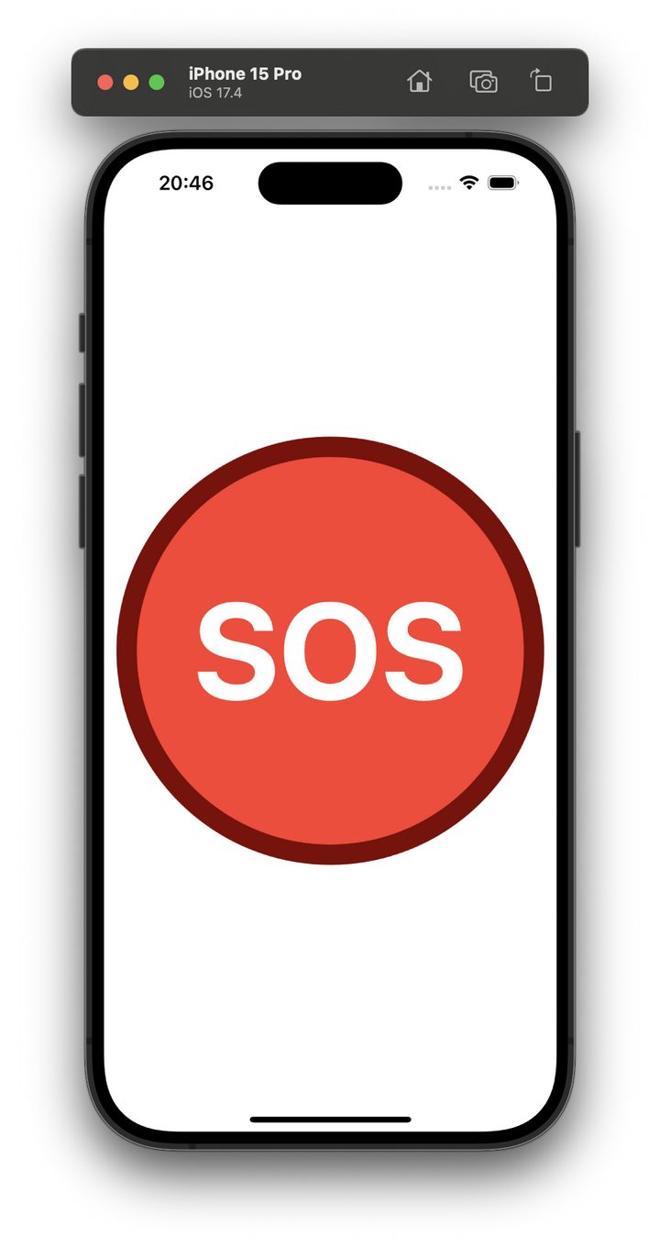
CISCO
SAFE SPACES
Pinpointing Help, Saving Lives
22/03/2024
St. Gallen, CH

Slide 3
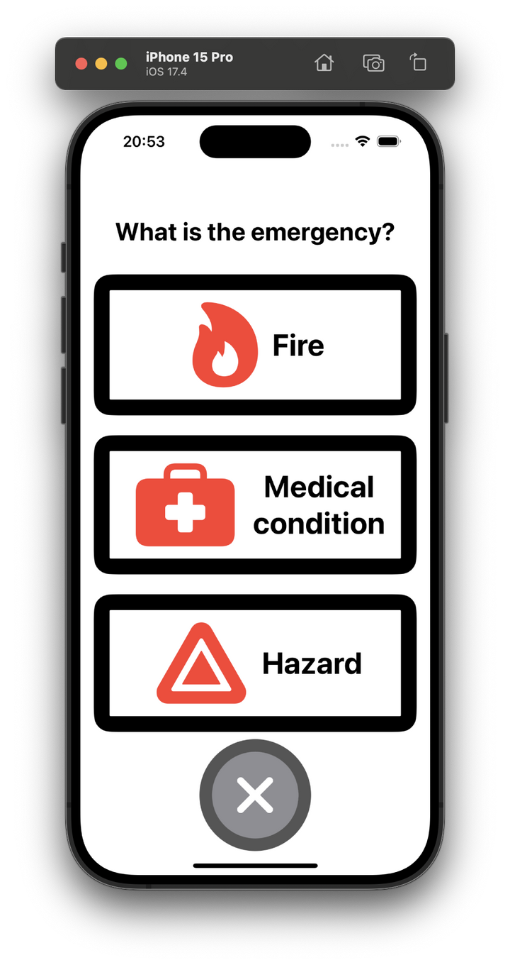
CISCO
01
Help at the click of a button: instantly notify emergency services without manual dialing
SAFE SPACES
Pinpointing Help, Saving Lives
02
Precise Location Tracking:
uses Cisco Spaces to provide precise location to emergency responders
03
Community Awareness:
alerts nearby users for immediate help

Slide 4
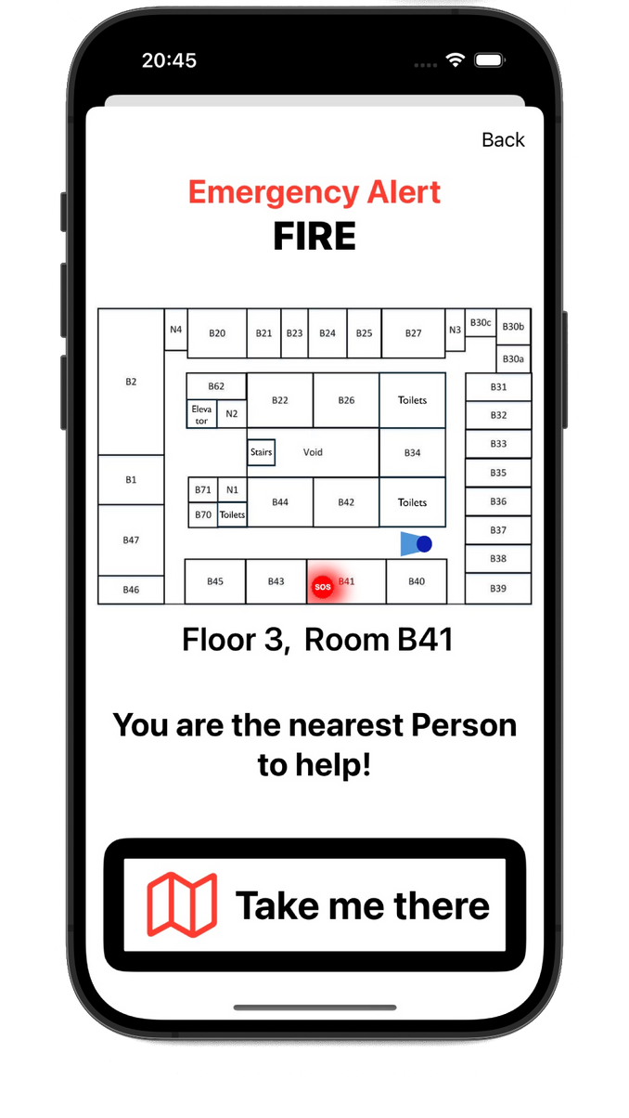
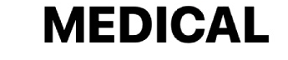
CISCO
01
FIRE: Emergency services receive all necessary info, users receive emergency location & instructions
SAFE SPACES
Pinpointing Help, Saving Lives
02
MEDICAL: Emergency services notified, nearby users receive location and instructions to help
03
HAZARD: Emergency services notified, users receive evacuation alert

Slide 5

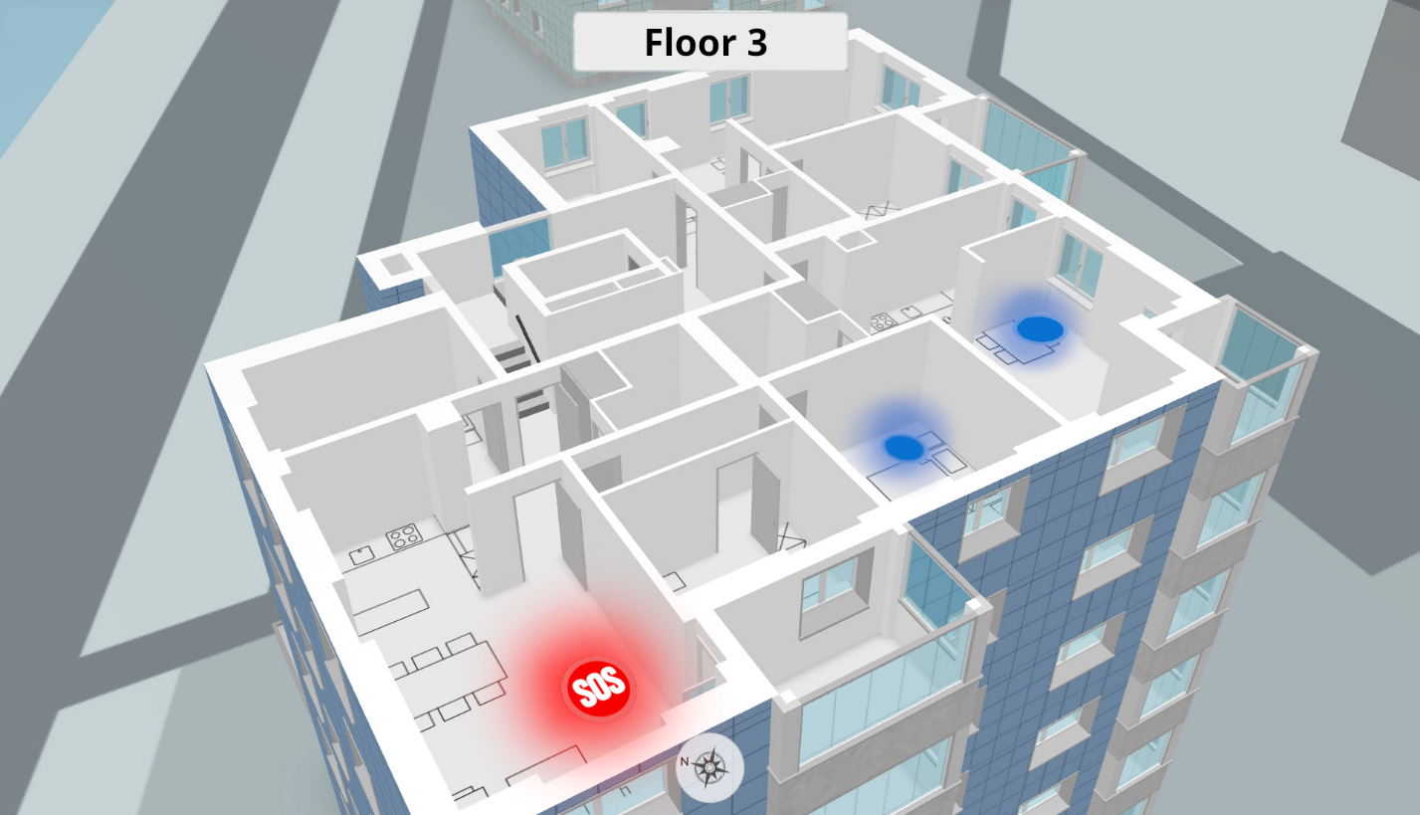
CISCO
SAFE SPACES
Pinpointing Help, Saving Lives
MEDICAL: Emergency services notified, nearby users receive location and instructions to help

Slide 6

CISCO
What Makes SafeSpaces Better?
guides both firefighters and affected users during emergencies
provides real-time location data and safest exit routes
quicker rescuing saves lives.
Why use it?
What's the Current Solution
relying on alarm systems for emergency evacuation
only effective in initiating the process
no information about missing people, no live location

Slide 7

CISCO
Conclusion
SafeSpaces enhances existing Cisco Spaces, initially targeting Cisco's current clientele
cost-effective solution for company-wide safety improvements
Saves Human Lives.
Let's create a safer world. Let's create SafeSpaces!

Slide 8
Thank You
22/03/2024
Pendi, Huber, Meierlohr, Hörter
St. Gallen, CH

